Slide 1
Estimation for Software Projects

Slide 2
Software Project Planning
goal of project planning
establish a strategy for controlling, tracking, and monitoring a complex technical project
the end result gets done on time, with quality

Slide 3
Project Planning Task Set
Establish project scope
Determine feasibility
Analyze risks
Risk analysis.
Define required resources
Determine require human resources
Define reusable software resources
Identify environmental resources
Decompose the problem
Develop two or more estimates using size, function points, process tasks or use-cases
Reconcile the estimates
Develop a project schedule
Scheduling
Establish a meaningful task set
Define a task network
Use scheduling tools to develop a timeline chart
Define schedule tracking mechanisms

Slide 4
Estimation
Estimation of resources, cost, and schedule for a software engineering effort requires
experience
access to good historical information (metrics)
the courage to commit to quantitative predictions when qualitative information is all that exists
Estimation carries inherent risk and this risk leads to uncertainty

Slide 5
Software Project Plan
Project Scope
Estimates
Risks
Schedule
Control strategy
Software Project Plan
Understand Scope
the customers needs
the business context
the project boundaries
the customer’s motivation
the likely paths for change

Slide 6
What is Scope?
Software scope describes
the functions and features that are to be delivered to end-users
the data that are input and output
the “content” that is presented to users as a consequence of using the software
the performance, constraints, interfaces, and reliability that bound the system.
Scope is defined using one of two techniques:
A narrative description of software scope is developed after communication with all stakeholders.
A set of use-cases is developed by end-users.

Slide 7
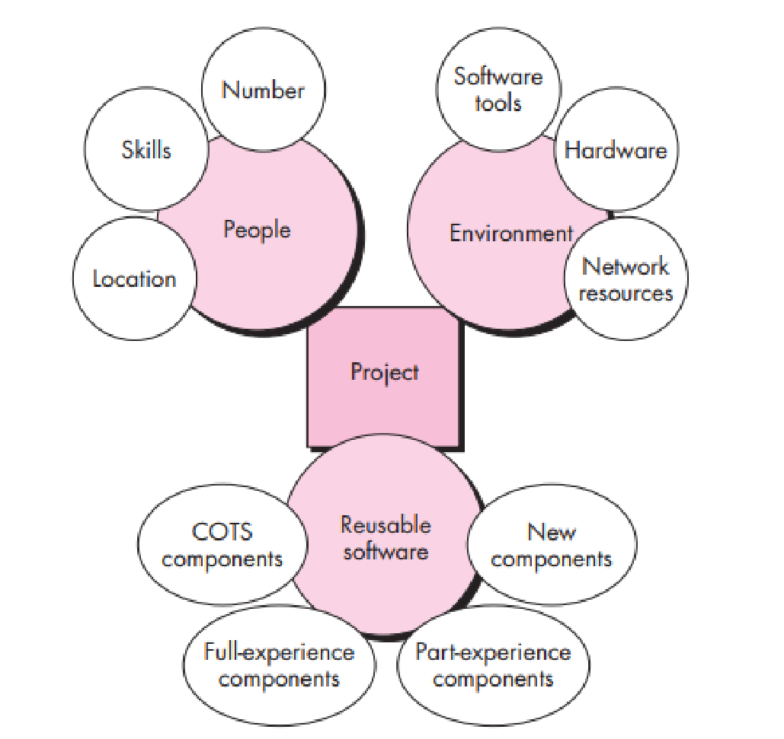
Project Resources

Slide 8
Project Estimation
Delay estimation until late in the project
Base estimates on similar projects that have already been completed.
Use relatively simple decomposition techniques to generate project cost and effort estimates.
Use one or more empirical models for software cost and effort estimation

Slide 9
DECOMPOSITION TECHNIQUES
Software Sizing (LOC or FP)
the degree to which you have properly estimated the size of the product to be built;
the ability to translate the size estimate into human effort, calendar time, and amount(a function of the availability of reliable software metrics from past projects)
the degree to which the project plan reflects the abilities of the software team
the stability of product requirements and the environment that supports the software engineering effort.
Sizing approaches
Fuzzy logic sizing
Function point sizing
Standard component sizing
Change sizing

Slide 10
Problem-Based Estimation LOC/FP Approach
compute LOC/FP using estimates of information domain values
use historical data to build estimates for the project
KLOC: kilo lines of code, or (lines of code) / 1000
Regarded as most accurate way to measure labor costs
Function points are computed by first calculating an unadjusted function point count (UFC).
Counts are made for the following categories·
External inputs – those items provided by the user that describe distinct application-oriented data (such as file names and menu selections)·
External outputs – those items provided to the user that generate distinct application-oriented data (such as reports and messages)

Slide 11
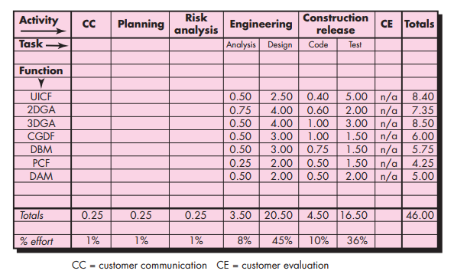
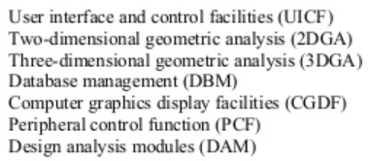
Process-Based Estimation
delineation of software functions obtained from the project scope
series of framework activities must be performed for each function

Slide 12
Estimation Accuracy
Predicated on
the degree to which the planner has properly estimated the size of the product to be built
the ability to translate the size estimate into human effort, calendar time, and dollars (a function of the availability of reliable software metrics from past projects)
the degree to which the project plan reflects the abilities of the software team
the stability of product requirements and the environment that supports the software engineering effort.

Slide 13

Empirical estimation model
estimation model is derived using regression analysis on data collected from past software projects.
where A, B, and C are empirically derived constants, E is effort in person-months, and e_{v} is the estimation variable (either LOC or FP
The COCOMO II Model (COnstructive COst MOdel )
Application composition model. Used during the early stages of software engineering, when prototyping of user interfaces, consideration of software and system interaction, assessment of performance, and evaluation of technology maturity are paramount.
Early design stage model. Used once requirements have been stabilized and basic software architecture has been established.
Post-architecture-stage model. Used during the construction of the software

Slide 14
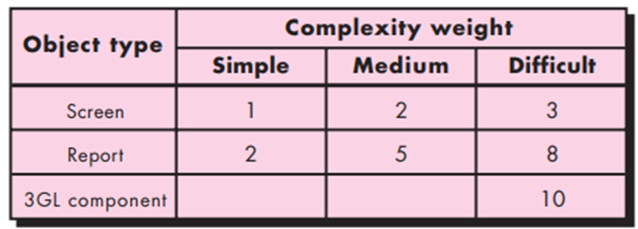
COCOMO MODEL II
Three different sizing options are available as part of the model hierarchy: object points, function points, and lines of source code
The object point count is determined by multiplying the original number of object instances by the weighting factor in the figure and summing to obtain a total object point count.

Slide 15
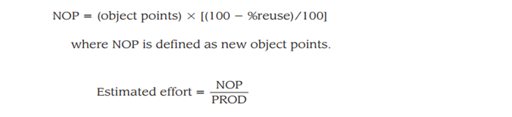
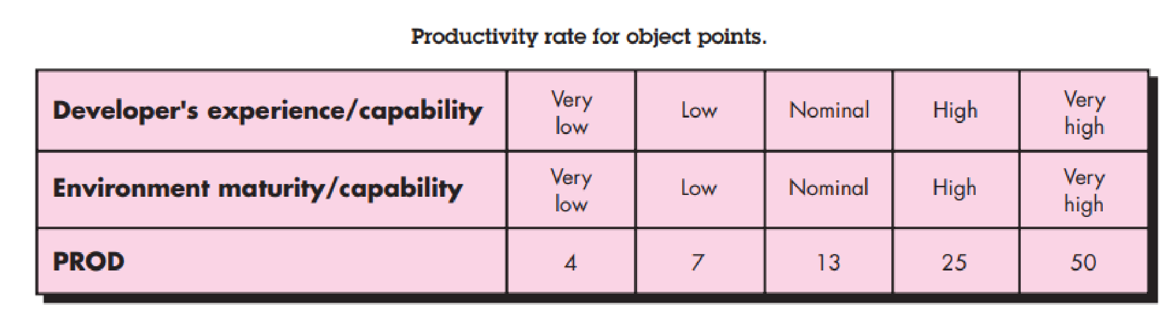
New Object Point (NOP)
Component-based development or general software reuse is to be applied, the percent of reuse (%reuse) is estimated and the object point count is adjusted

Slide 16

The Software Equation
A dynamic multivariable model
Where E = effort in person-months or person-years
t = project duration in months or years
B = “special skills factor”
P = “productivity parameter”
overall process maturity
management practices,
good software engineering practices
level of programming languages used
the state of the software environment
the skills and experience of the software team
the complexity of the application

Slide 17
Estimation for Agile Projects
Each user scenario (a mini-use-case) is considered separately for estimation purposes.
The scenario is decomposed into the set of software engineering tasks that will be required to develop it.
Each task is estimated separately.
estimation based on historical data, an empirical model, or “experience.”
Alternatively, the ‘volume’ of the scenario can be estimated in LOC, FP or some other volume-oriented measure (e.g., use-case count).
Estimates for each task are summed to create an estimate for the scenario.
Alternatively, the volume estimate for the scenario is translated into effort using historical data.
The effort estimates for all scenarios that are to be implemented for a given software increment are summed to develop the effort estimate for the increment.

Slide 20
The Make-Buy Decision
Software may be purchased (or licensed) off-the-shelf
“full-experience” or “partial-experience” software components may be acquired and then modified and integrated to meet specific needs
Software may be custom built by an outside contractor to meet the purchaser’s specifications
In the final analysis, the make/buy decision is made based on the following conditions:
Will the delivery date of the software product be sooner than that for internally developed software?
Will the cost of acquisition plus the cost of customization be less than the cost of developing the software internally?
Will the cost of outside support (e.g., a maintenance contract) be less than the cost of internal support?

Slide 21
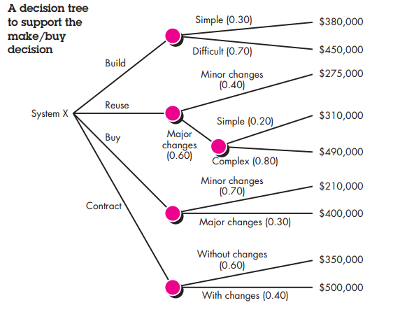
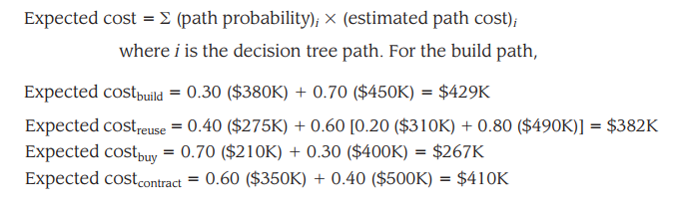

Slide 22
Outsourcing
Software engineering activities are contracted to a third party who does the work at lower cost and, hopefully, higher quality.
Software work conducted within a company is reduced to a contract management activity
At the strategic level, business managers consider whether a significant portion of all software work can be contracted to others.
At the tactical level, a project manager determines whether part or all of a project can be best accomplished by subcontracting the software work.
The outsourcing decision is often a financial one
On the positive side, cost savings can usually be achieved by reducing the number of software people and the facilities (e.g., computers, infrastructure) that support them.
On the negative side, a company loses some control over the software that it needs.

